Slide 1
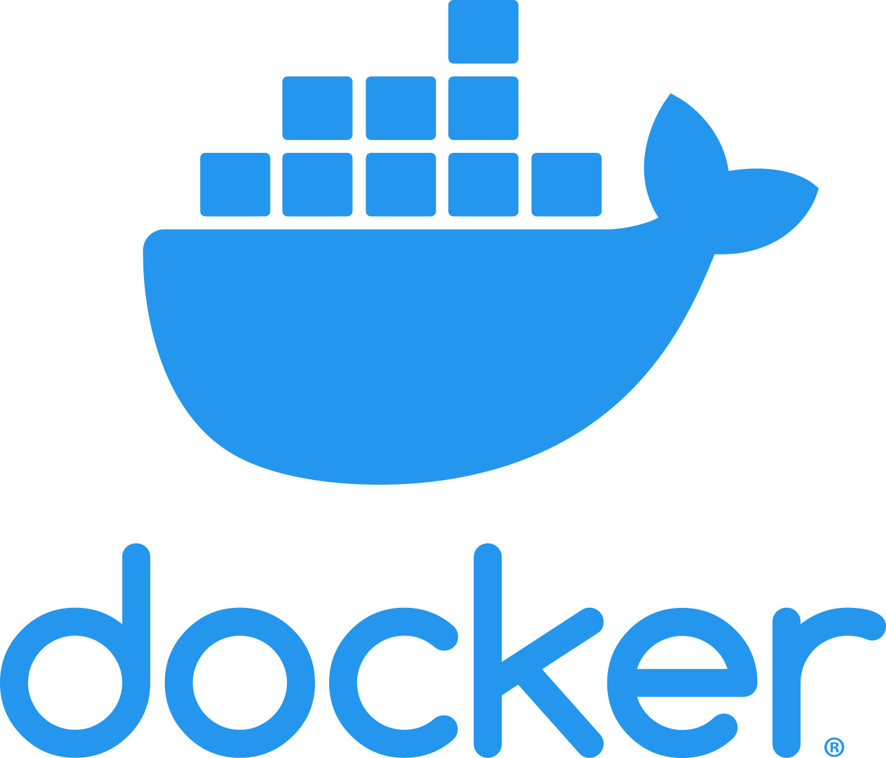

Slide 2
Agenda
What resources are required to run an application.
Traditional way of hosting an applications.
Why we need virtualization?
Why we need Container?
Difference between VM and Container.
What is container.
What is Docker?

Slide 3
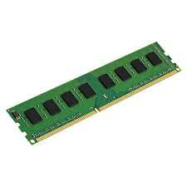
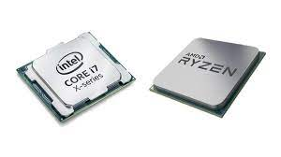
Application
RAM
CPU
Disk
Libraries
Binaries
Physical Server
Operating System

Slide 4
In 1990
Let’s assume, we are in 1990 and there is no Virtualization concept in the market. We need to deploy 3 application servers, i.e. NodeJS , DNS and DHCP servers.
Each application may share the Operating System (OS) libraries, thus, we installed these applications on separate hardware.
Each server should have at least 4 GB RAM, 20 GB Hard disk and 2 CPU. Very minimal configuration we opt for this.

Slide 5
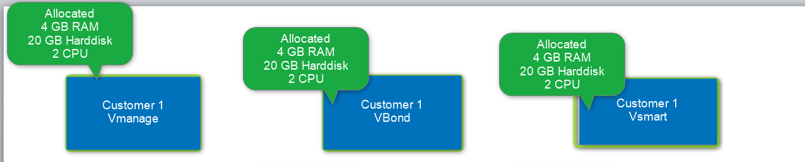
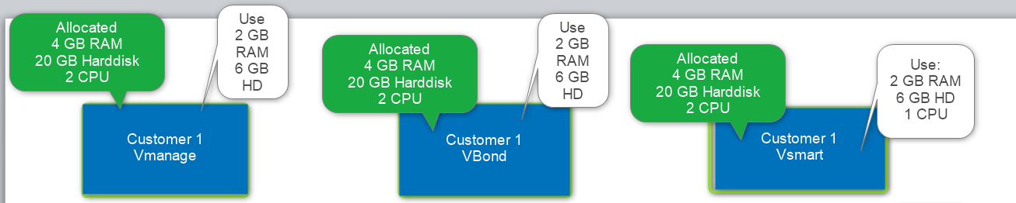
Each server should have at least 4 GB RAM, 20 GB Hard disk and 2 CPU. Very minimal configuration we opt for this.
However, they consume less resources.

Slide 6
 | Allocated | Used | Waste
Total RAM | 12 GB | 6 GB | 6 GB
Hard disk | 60 GB HD | 18 GB | 42 GB
CPU | 6 | 3 | 3
On the top of that below points also need to be considered.
3 Servers Hosting space
Physical cabling
Power adapter
Physical switch
Lot of manual work

Slide 7
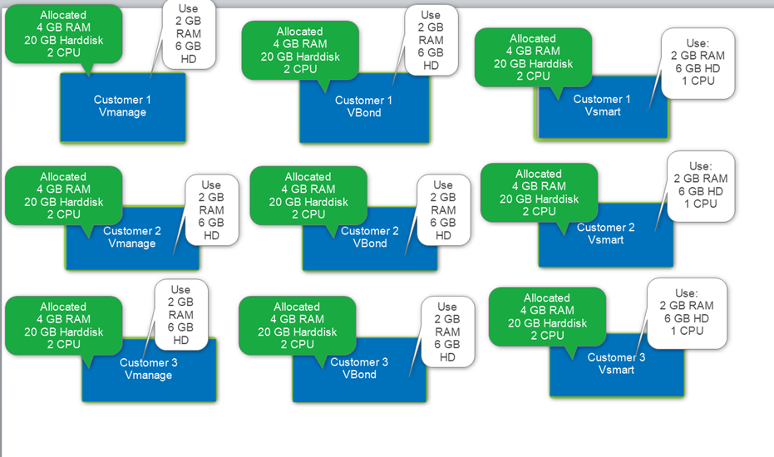
Now, imagine, we have 3 customers and therefore, we have to deploy 9 servers for them.

Slide 8
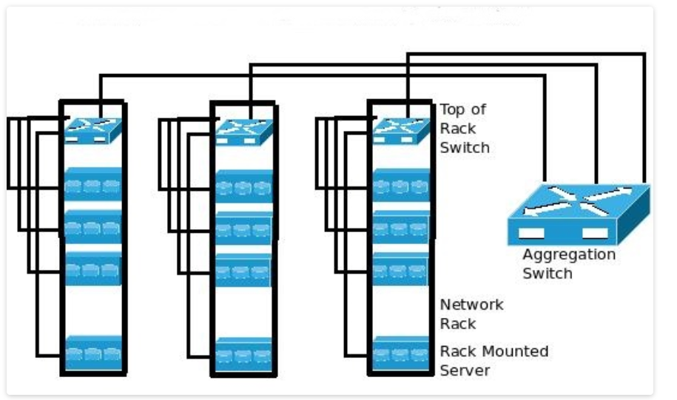

Slide 9
Now, if we need a replica of these servers then we need another 9 servers.
9 Servers Hosting space
Physical cabling
Power adapter
Physical switch
Lot of manual work
 | Allocated | Used | Waste
Total RAM | 36 GB | 18 GB | 18 GB
Hard disk | 180 GB HD | 54 GB | 126 GB
CPU | 18 | 9 | 9

Slide 10
Virtual Machines
Resources Utilization
Physical server
Virtual Machine
Virtual Machine
Virtual Machine
Applications
Guest OS 3
Application Node JS
Application NGINX
Application Apache
Guest OS 2
Guest OS 1
Guest Operating system
Guest Operating system
Guest Operating system
Hypervisor
Hypervisor

Slide 11
containerization
Resources Utilization
Physical server
Container
Container
Container
Container
Container
Container
Application
Node JS
NGINX
Apache
App 1
App 2
App 3
Container
Container Engine(Docker)
Guest OS
Guest Operating system

Slide 12
Comparison between Container and VM
Physical server
Physical server
Virtual Machine
Virtual Machine
Virtual Machine
Container
Container
Container
Container
Container
Container
Application Node JS
Application NGINX
Application Apache
Node JS
NGINX
Apache
App 1
App 2
App 3
Guest Operating system
Guest Operating system
Guest Operating system
Container Engine(Docker)
Hypervisor
Guest Operating system

Slide 13
Containers in the VM
Physical server
Virtual Machine
Virtual Machine
Virtual Machine
Virtual Machine
Container
Container
App 1
App 2
Application Node JS
Application NGINX
Application Apache
Container Engine
Guest Operating system
Guest Operating system
Guest Operating system
Guest Operating system
Hypervisor

Slide 14
What is Container
Application
RAM
CPU
Disk
Libraries
Binaries
Physical Server
Operating System

Slide 15
Installation of Apache server (Application)
apt-get -y install apache2
sed -i '$a\ServerName 127.0.0.1' /etc/apache2/apache2.conf
mkdir /var/www/container1/
cd /var/www/container1/
cat > index.html <<EOF
This is my webserver1
EOF
cd /etc/apache2
service apache2 start
cd /etc/apache2/sites-available/
cp 000-default.conf container1.conf
sed -i 's=DocumentRoot /var/www/html=DocumentRoot /var/www/container1/=' container1.conf
sed -i '/container1/ a \\tServerName localhost' container1.conf
a2ensite container1.conf
a2dissite 000-default.conf
service apache2 reload

Slide 16

Application
(Apache Web server)
LIB and BIN
Container
container is a standard unit of software that packages up code and all its dependencies so the application runs quickly and reliably from one computing environment to another.

Slide 17
What is docker

Slide 18
Docker is an open platform for developing, shipping, and running applications. Docker enables you to separate your applications from your infrastructure so you can deliver software quickly.
With Docker, you can manage your infrastructure in the same ways you manage your applications. By taking advantage of Docker’s methodologies for shipping, testing, and deploying code quickly.
You can significantly reduce the delay between writing code and running it in production.
https://docs.docker.com/get-started/overview/

